Slide 1

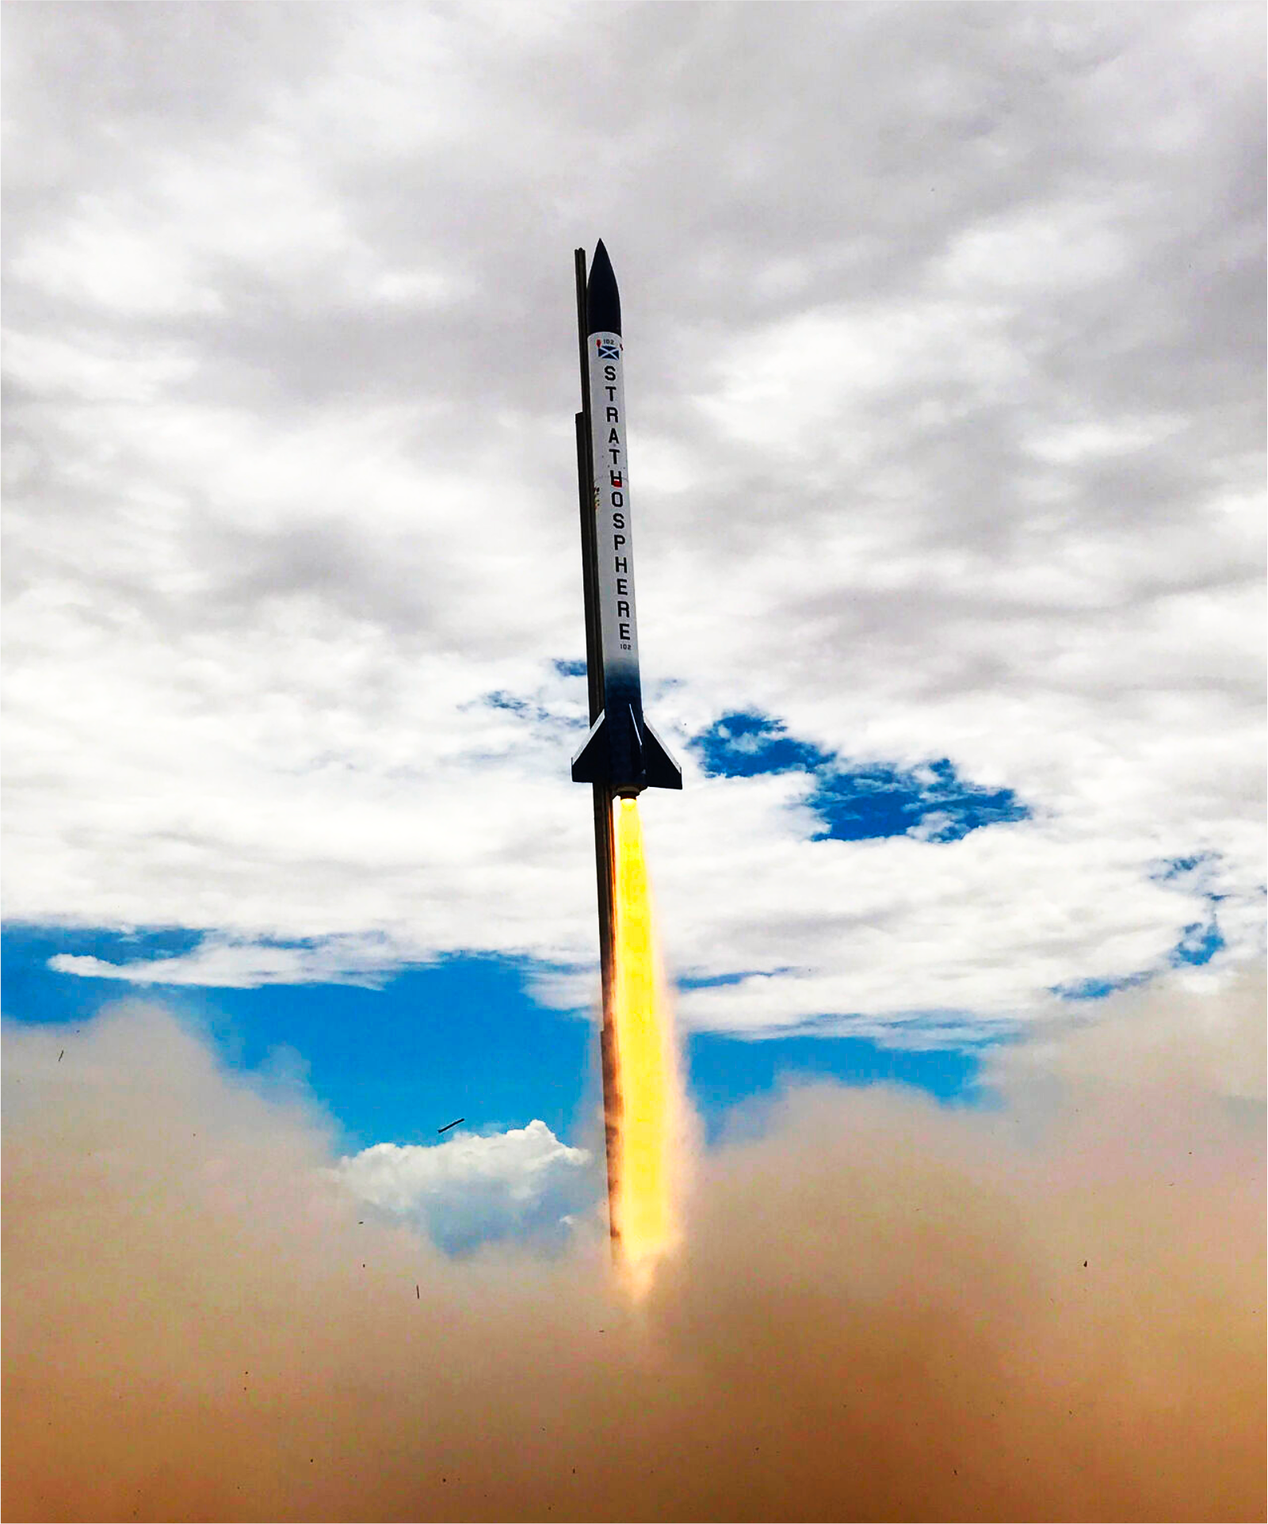
Avionics

Slide 2
This meeting’s going to be more free form
Power management
Telemetry visualization
SRAD flight computer
SRAD radio
SRAD GPS

Slide 3
Right, you’re all bored as hell now
What’ve you lot got to say to me?
I’m sure you have notes

Slide 4
Aurelija
I have stuff to say on the power board.
This is a threat.

